Slide 1


Optimizing Decentralized Window Aggregation
Hasso-Plattner-Institut Potsdam,
Data Engineering System
Notes:
Hi everyone, my name is wang, I am from Data Engineering System group, In this presentation, I would like to give you a quick overview of our work on multi-query aggregation optimization in distributed stream processing. In this work we focus on hierarchical, distributed sensor network that are analyzed with many windowed stream queries. And we propose a new optimizer with our system, it slices original windows, and share the intermediate results of overlaps even though they have different window types. Also, we generate the process plan for each window and share the result of operators between plans which have different aggregation functions.

Slide 2



Background
stream processing
Average speed of cars?

Slide 3


Background
stream processing
Queries
ML System
Data Stream
Stream Processor
Result Stream
Stream Processor
Potentially unlimited data set
Many different queries
Continuous results
Notes:
Given a long continuous query the system has to periodically calculate and output its result
Firstly

Slide 4
Background
window
The most common way to process an unbounded dataset using repeated runs
of a batch engine is by windowing the input data into fixed-size windows and
then processing each of those windows as a separate.
- Streaming Systems by Tyler Akidau
Time-based | Count-based
Tumbling | Counting
Sliding
Session
User-define
Notes:
Given a long continuous query the system has to periodically calculate and output its result
Firstly

Slide 5
Background
aggregation function
Aggregation Function is the approach to calculate data that in a window.
decomposable | Non-decomposable
Average | Median
Max
Min
Count
Notes:
Given a long continuous query the system has to periodically calculate and output its result
Firstly

Slide 6
Background
aggregation function
Aggregation Function is the approach to calculate data that in a window.
average = ?
decomposable | Non-decomposable
Average | Median
Max
Min
Count
=
=
=
partial average + partial average + partial average
average
Notes:
Given a long continuous query the system has to periodically calculate and output its result
Firstly

Slide 7

Background
aggregation function
Aggregation Function is the approach to calculate data that in a window.
median = ?
decomposable | Non-decomposable
Average | Median
Max
Min
Count
=
=
=
partial median + partial median + partial median
median
Notes:
Given a long continuous query the system has to periodically calculate and output its result
Firstly

Slide 8
Background
What is window aggregation?
SELECT MAX(wstart), wend, average(Speed)
FROM Tumble(data => Table(RawData),
timecol => DESCRIPTOR(time),
dur => INTERVAL '5' Second)
Tumbling window
Average
5 seconds
time = ?
Notes:
Given a long continuous query the system has to periodically calculate and output its result
Firstly

Slide 9

Background
What is window aggregation?
SELECT MAX(wstart), wend, average(Speed)
FROM Tumble(data => Table(RawData),
timecol => DESCRIPTOR(time),
dur => INTERVAL '5' Second)
Tumbling window
Average
average
time = 5s

Slide 10

Background
Use Case
users
Query 1: the average speed of cars
Driver Profile
Route Profile
Real-Time Alerting

Slide 11
Background
Use Case
users
Q1: the average speed of cars
Q2 :Max speed of car

Slide 12

Challenge
Current SPEs?
Production-ready SPEs:
SPEs
Flink/Spark/Storm
Distributed Network
Sharing Computation
root
Research Prototypes:
local
local
local
local
local
LEACH/Disco/Scotty
Distributed Network
Sharing Computation

Slide 13
Research Goal
Efficient share intermediate result between multiple arbitrary streamed queries in distributed network
Distributed Network
Share Computation
General Applicability
Runtime Optimizations

Slide 14
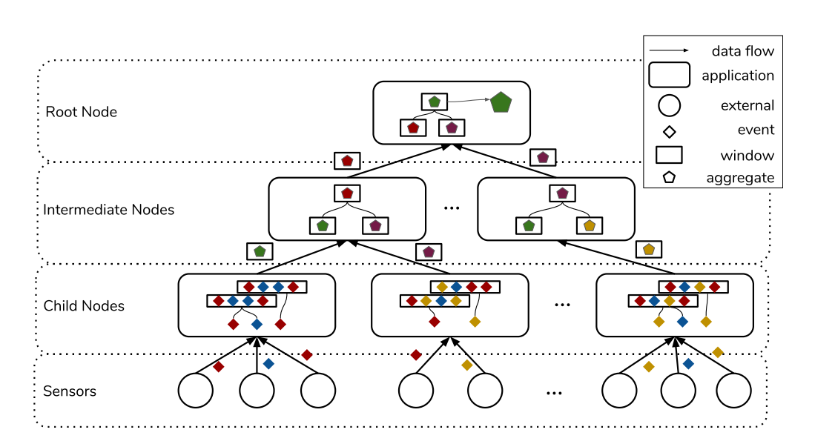
Related Work Disco
1. Pre-aggregate
2. Final-aggregate
Time-based window
Count-based window
Benson, Lawrence, et al. "Disco: Efficient Distributed Window Aggregation." EDBT. Vol. 20. 2020.

Slide 15
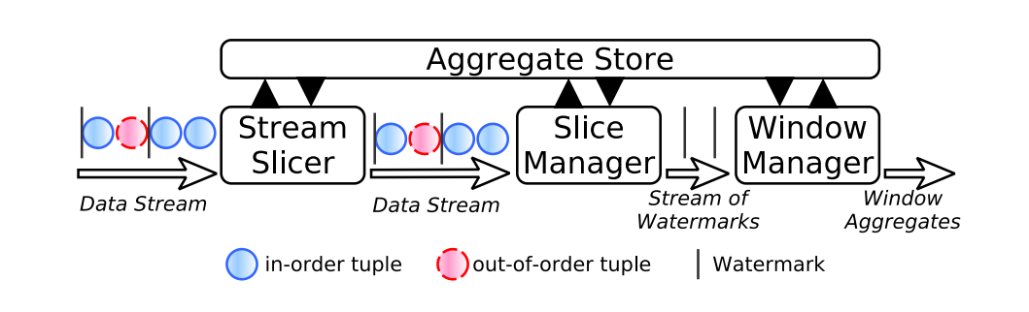
Related Work scotty
pre-aggregation
result sharing
Traub, Jonas. "Demand-based data stream gathering, processing, and transmission." (2019). Chapter 4

Slide 16
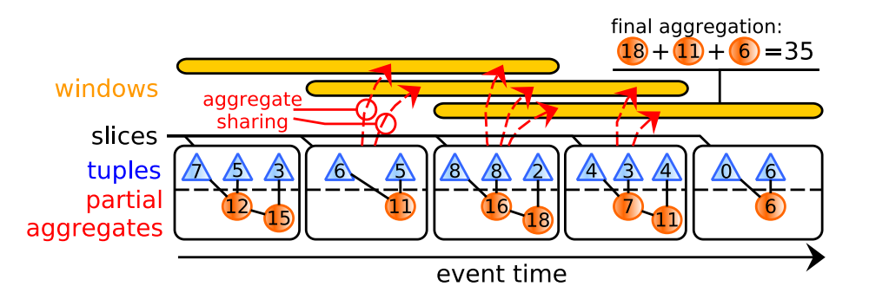
Related Work scotty
Basic Idea
pre-aggregation
result sharing
Traub, Jonas. "Demand-based data stream gathering, processing, and transmission." (2019). Chapter 4

Slide 17
Related Work scotty
Result Sharing
Different Measures
Different Window Types
Different Aggregation Functions
Traub, Jonas. "Demand-based data stream gathering, processing, and transmission." (2019). Chapter 4
Notes:
Session tumbling sliding

Slide 18
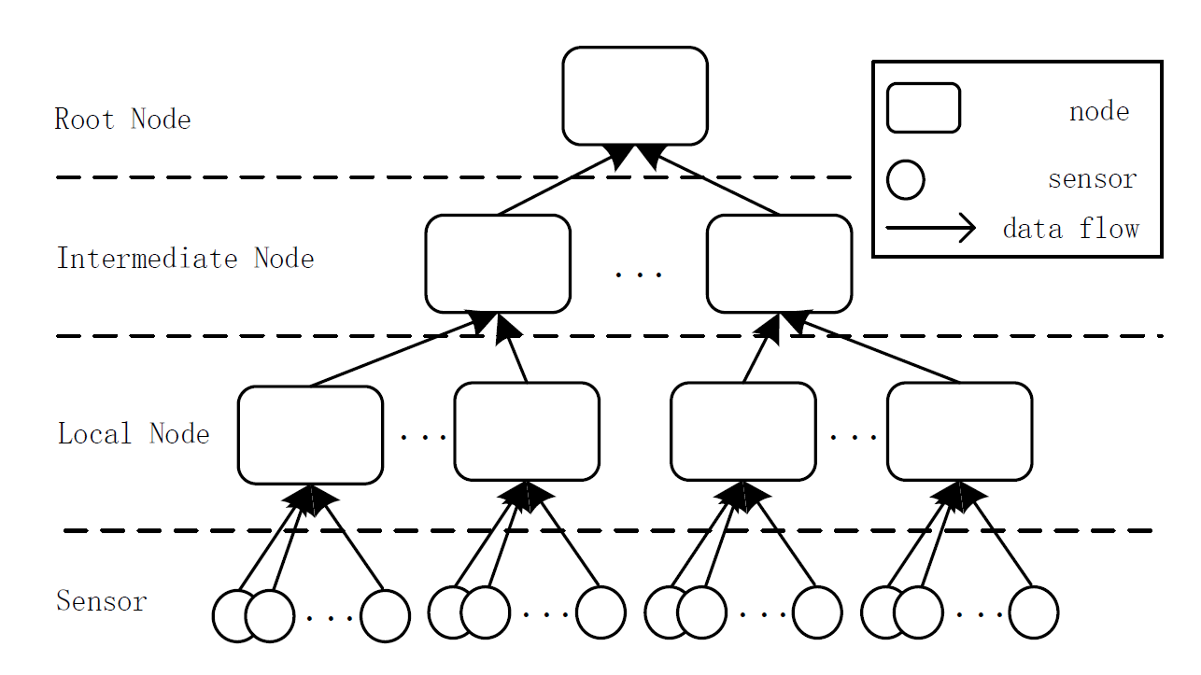
Our Solution
structure
Benson, Lawrence, et al. "Disco: Efficient Distributed Window Aggregation." EDBT. Vol. 20. 2020.

Slide 19
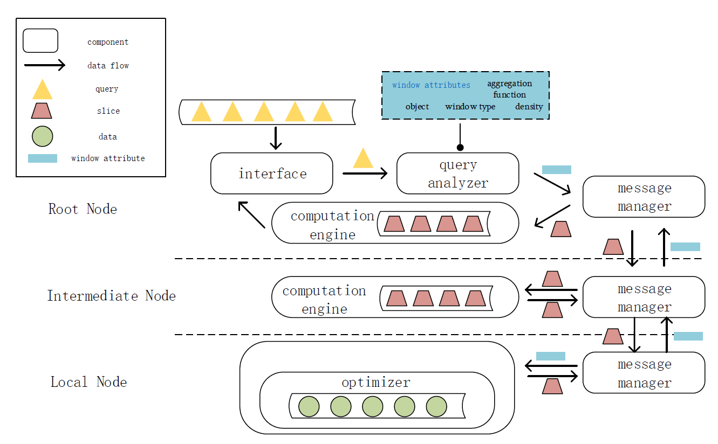
Our Solution
architecture
Notes:
5

Slide 20
Our Solution
Query Analyzer
Query
Window
Solution
 | Decomposable | Non-Decomposable
Tumbling | decentralized Aggregation | Centralized Aggregation
Sliding
Session
Count-based
User-define

Slide 21
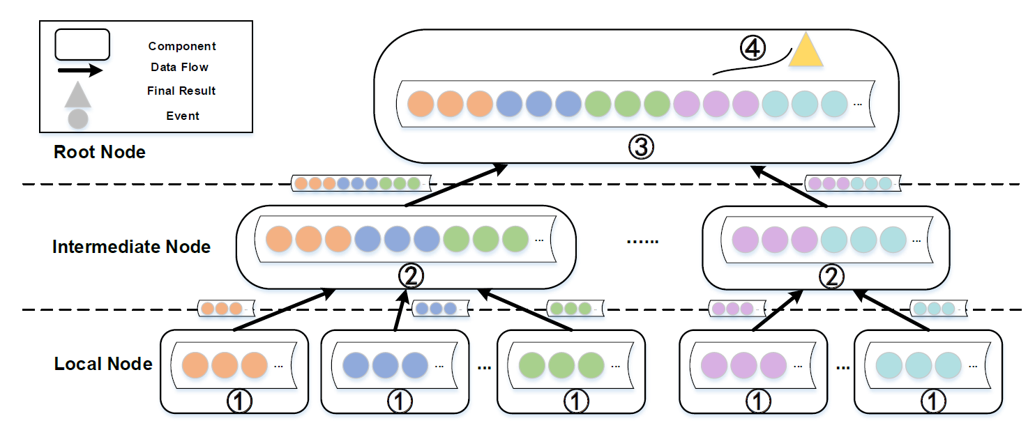
Our Solution
centralized aggregation

Slide 22
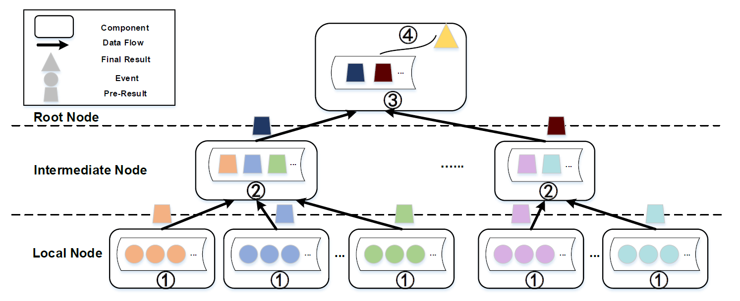
Our Solution
decentralized aggregation

Slide 23
Our Solution
optimizer
Query
Window
Solution
Queries | Window Type | Aggregation Function
Q_{a} | Tumbling | Sum
Q_{b} | Sliding | Average
Q_{c} | Session | Median

Slide 24
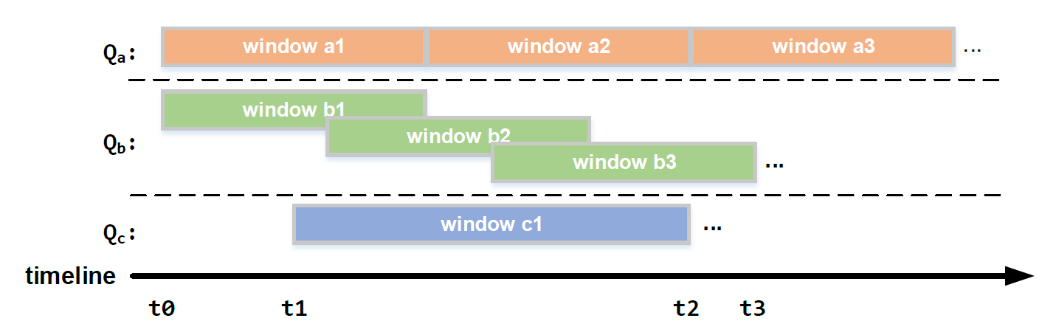
Our Solution
Optimizer – window type & measures
Basic idea: share overlap between windows
Notes:
Least common multiple

Slide 25
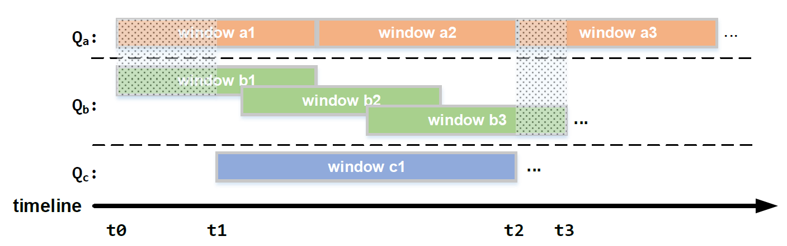
Our Solution
Optimizer – window type & measures
Basic idea: share overlap between windows
Notes:
Least common multiple

Slide 26
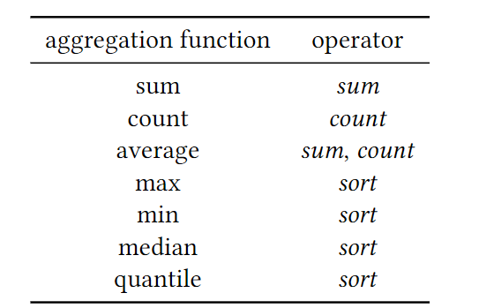
Our Solution
Optimizer – aggregation function
Queries | Aggregation Function
Q_{a} | Sum
Q_{b} | Average
Q_{c} | Median
Break down functions into operators.
Share results of operators.
Notes:
Least common multiple
Sw2 => slice

Slide 27
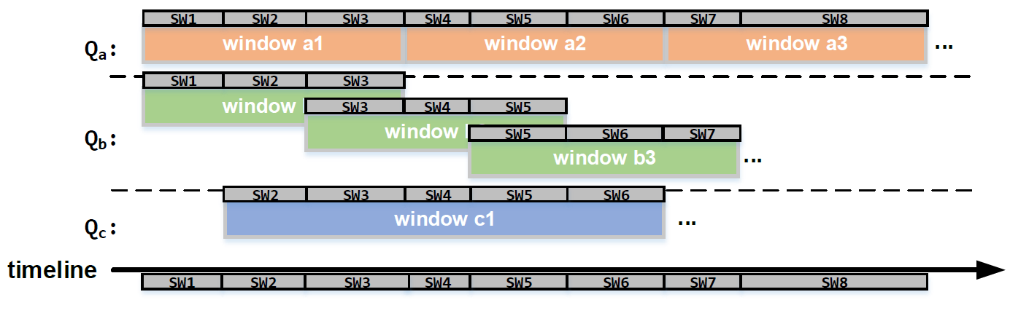
Our Solution Optimizer
Notes:
Least common multiple

Slide 28
Evaluation design
I. Setup
7 nodes, 96 GB RAM, 18 Cores
II. Dataset
https://debs.org/grand-challenges/2013/
III. Baseline
Scotty
Disco
Centralized System (Central)
ScottyPro
IV. Workload
System Performance
System Optimization
Notes:
The physical map!!!!!!!

Slide 29
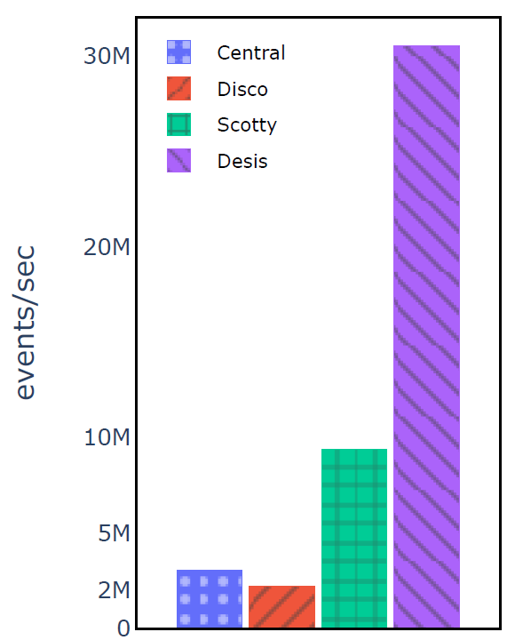
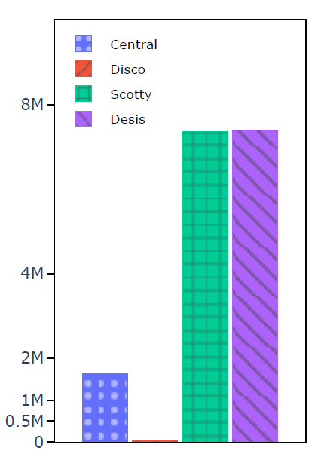
Evaluation System Performance
Throughput
Query1 : tumbling window
Query2 : tumbling window
Q1- Average
Q2-Median
Notes:
30%

Slide 30
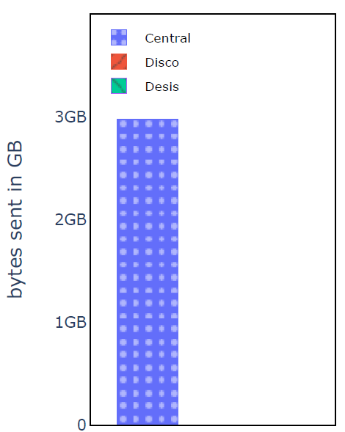
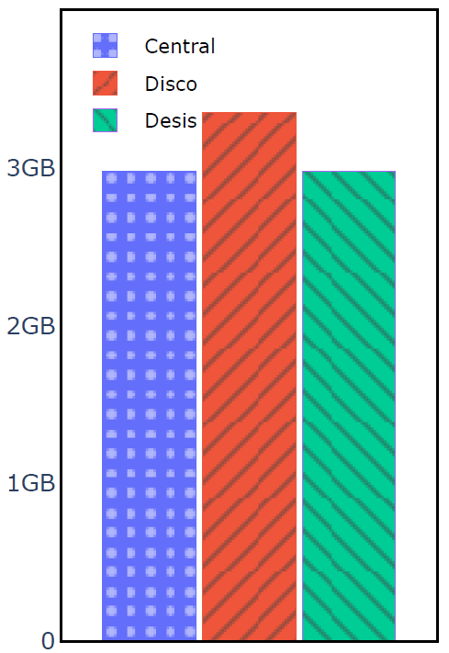
Evaluation System Performance
Network Overhead
Query1 : tumbling window
Query2 : tumbling window
Q1- Average
Q2-Median
Notes:
30%

Slide 31
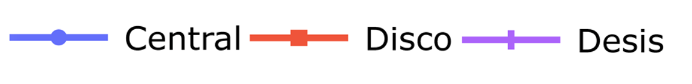
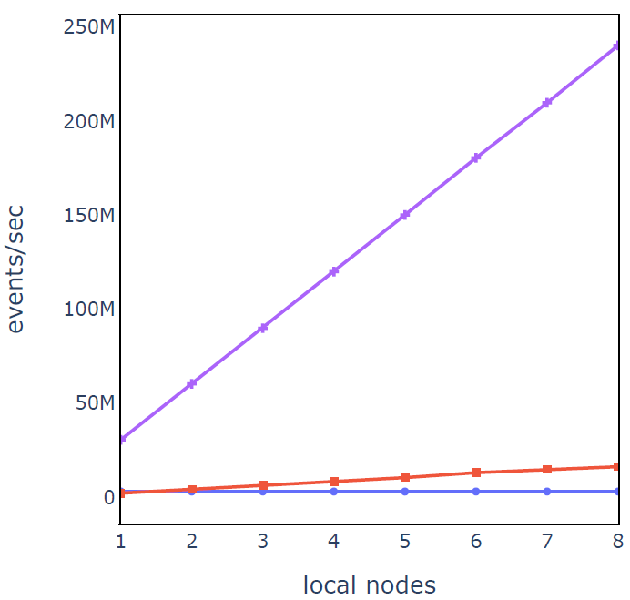
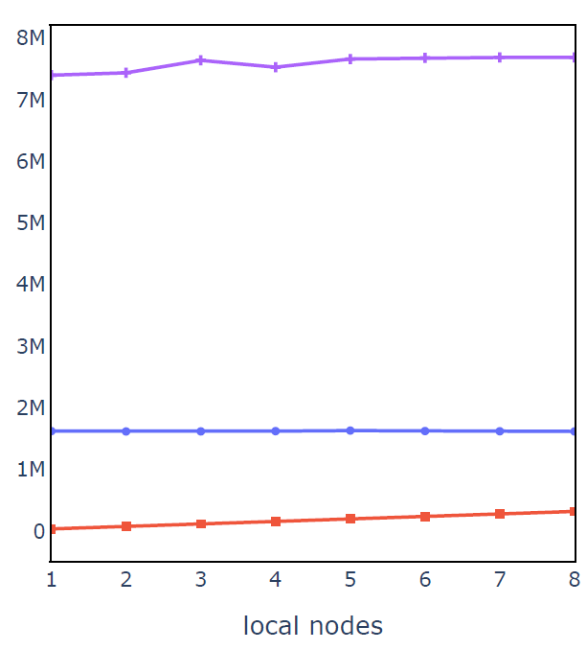
Evaluation System Performance
Scalability
Query1 : tumbling window
Query2 : tumbling window
Q1- Average
Q2-Median
Notes:
30%

Slide 32
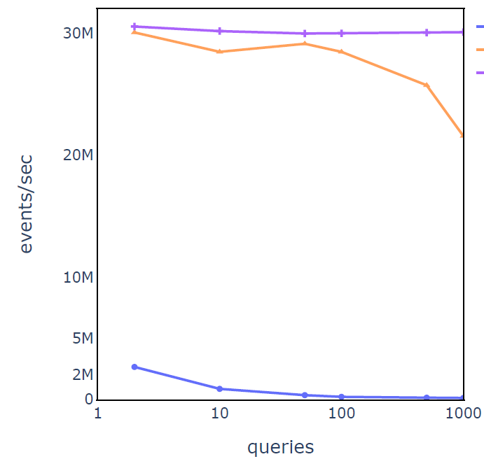
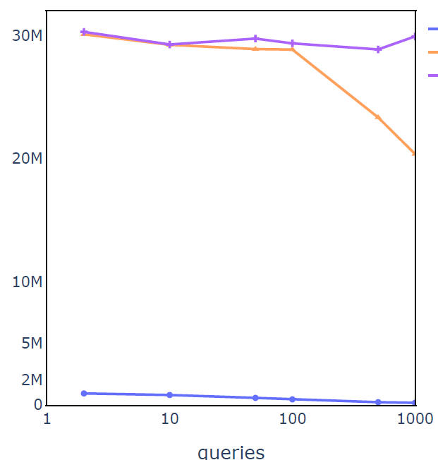
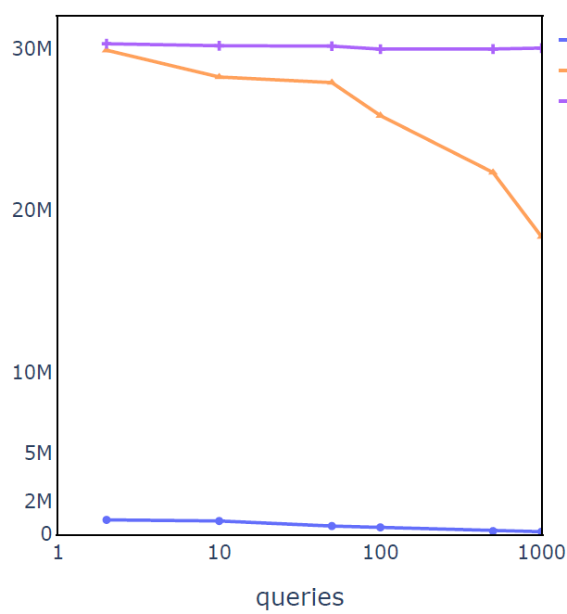
Evaluation System Optimization
Throughput
Window Sharing
Tumbling
Punctuation
Punctuation + Tumbling
Notes:
30%

Slide 33
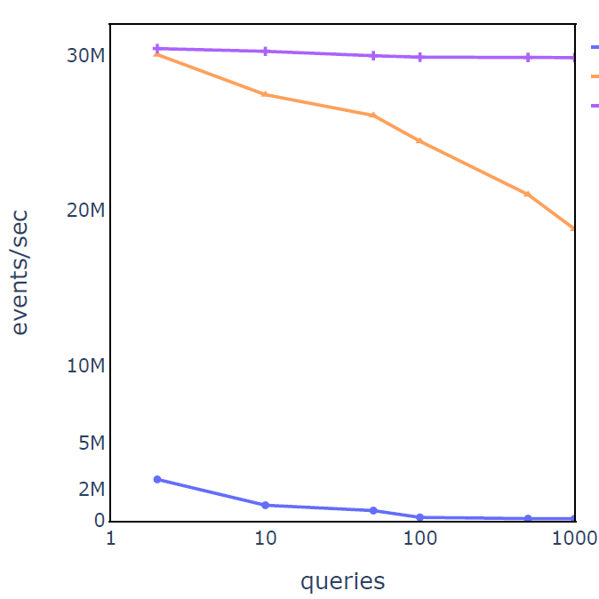
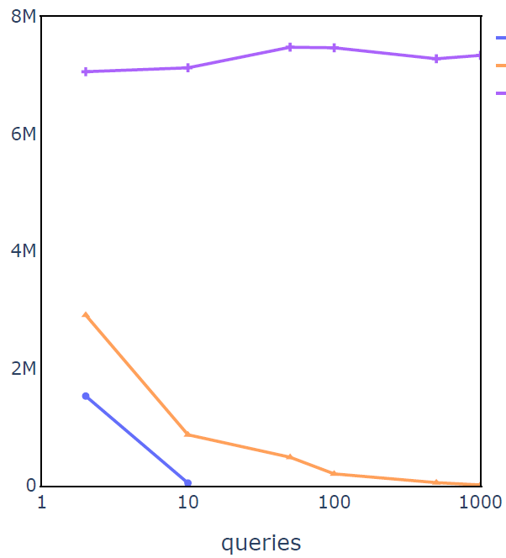
Evaluation System Optimization
Throughput
Function Sharing
Average + Sum
Quantile
Notes:
30%

Slide 34
Thanks!

